Slide 1



HTML 5
Nilesh Singh

Slide 2

Introduction
1) HTML5 will be the new standard for HTML(Hyper text
transfer protocol).
2) HTML 5 is a cooperation between the World Wide Web
Consortium (W3C)
and the Web Hypertext Application Technology Working
Group (WHATWG).
3) WHATWG was working with web form and application
4) W3C was working with XHTML2.0
5) In 2006 both decided to cooperate and create new form of
HTML
Wednesday 5 December 2012

Slide 3
Some rules for HTML5 were established:
1) new features should be based on
HTML, CSS, and JavaScript
2) Reduce the need for external plugins (like Flash)
3) Better error handling
4) More markup to replace scripting
5) HTML5 should be device independent
6) keep the development process should be visible to the public

Slide 4
New syntax and semantics in HTML5
<article>...</article>
<command>... </command>
<figure>...</ figure >
<aside>...</ aside >
<detail>... </detail>
<summery>...</ summery >
<header>... </header>
<footer>... </footer>
Etc.........

Slide 5
New Media Elements
<audio>...</audio>
<source>...</source>
<video>... <video>...
New <canvas> Element
<canvas>... <canvas>

Slide 6
New Form Elements
<datalist>
<keygen>
<output>
- Obsolete elements from HTML 4, not used in HTML 5
<acronym>,<applet>
<basefont>,<big>,<center>
<dir>etc.

Slide 7
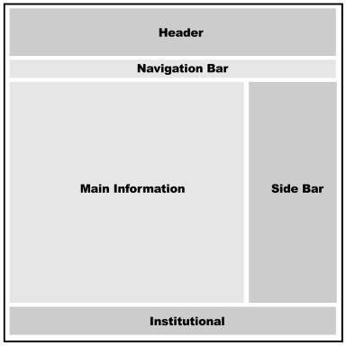
Organization
(visual representation of a typical web page layout)
Figure : represents a regular layout found in most websites, at the moment. Despite the fact that every designer creates his or her own designs, in general we will be able to identify every website studied, in terms of the following sections:

Slide 8
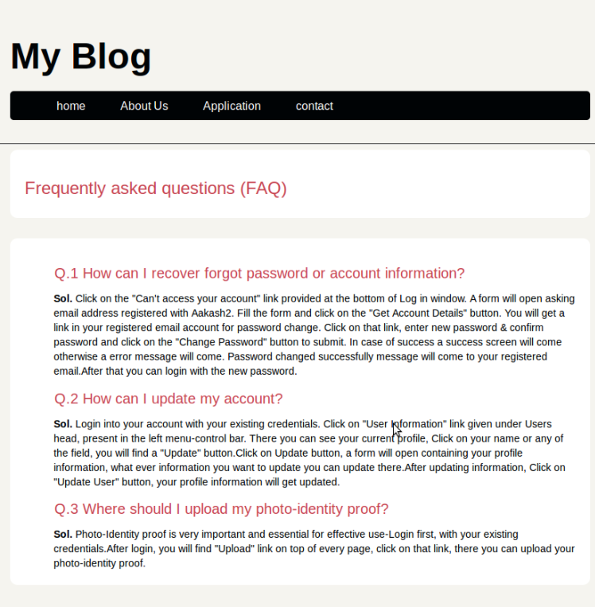
<header />
<nav />
HTML 5 Tags
1- Header
2- Navigation Bar
3- Main Information(section)
4- Side Bar
5- Footer
<section />
<footer />

Slide 9
New Structural Elements Example

Slide 10
Media Elements
<video width="320" height="240" controls>
<source src="movie.mp4" type="video/mp4">
<source src="movie.ogg" type="video/ogg">
</video>

Slide 11
Video Example

Slide 12
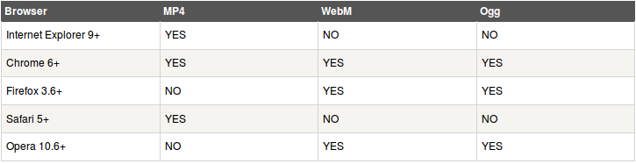
Video Formats and Browser Support

Slide 13

<canvas> Element
1) The <canvas> element is used to draw graphics,
on the webpage surface .
2) Draw a red rectangle, a gradient rectangle, a multicolour
rectangle, and some text onto the canvas:
HI

Slide 14
Create a Canvas
A canvas is a rectangular area on an HTML page, and it is specified with the <canvas> element.
<canvas id="myCanvas" width="200" height="100"></canvas>
Canvas - Paths
To draw straight lines on a canvas, we will use the following two methods:
moveTo(x,y) defines the starting point of the line
lineTo(x,y) defines the ending point of the line
Canvas – Text
Canvas – Gradients
Canvas - Images

Slide 15


Drag and Drop API
Drag and drop is a very common feature. With it you ‘grab’ an object and drag it to a different location.
In HTML5, drag and drop is part of the standard, and any element can be draggable.
Drag & drop
Sourse block
Destination block

Slide 16
Make an Element Draggable
<img draggable="true">
What to Drag - ondragstart and setData()
function drag(ev)
{
ev.dataTransfer.setData("Text",ev.target.id);
}
Where to Drop - ondragover
Here I am using Scripting language
event.preventDefault()

Slide 17
Perform Drop Function- ondrop
function drop(ev)
{
ev.preventDefault();
var data=ev.dataTransfer.getData("Text");
ev.target.appendChild(document.getElementById(data));
}

Slide 18
Drag and Drop API

Slide 19
File API
The HTML5 File API allows developers to interact
with the local file system on the client-side.
- File – Provides read-only information such as name, type, size, and last modified date.
- FileList – Contains the list of all file objects,
when handling selection of multiple files.
- FileReader – An Object to read the file.
Reference
http://speckyboy.com/2012/10/30/getting-to-grips-with-the-html5-file-api-2/..[5]

Slide 20
Handle selection of a single file.
<input type="file" id="file" name="file">
Handle a selection of multiple files.
<input type="file" id="files" name="files[]" multiple>

Slide 21
File API Example

Slide 22
MathML
- The HTML syntax of HTML5, allows for MathML elements to be used inside a document, using math tags.
- Most of the web browsers can display MathML tags.
Syntax :
<math>
...
...
</math>
http://www.tutorialspoint.com/html5/html5_mathml.htm

Slide 23
MathML...(2)
<math>
<mrow>
<msup><mi>a</mi><mn>2</mn></msup>
<mo>+</mo>
<msup><mi>b</mi><mn>2</mn></msup>
<mo>=</mo>
<msup><mi>c</mi><mn>2</mn></msup>
</mrow>
</math>
OUTPUT : a² + b² = c²

Slide 24
Matrix Presentation Examples

Slide 25
Example
HTML + CSS
(Cascading style sheet)

Slide 26
Example...(2)
HTML + CSS

Slide 27
Summary
- W3C and WHATWG
- Structural Element
- Video Element
- Drag and drop
- File API
- Canvas
- Video Formats and Browser Support
- MathML

Slide 28
References
1) https://developer.mozilla.org/en-US/demos/tag/tech:html5
2) www.w3schools.com/html5/
3) www.w3schools.com/html/html5_canvas.asp
4) http://www.tutorialspoint.com/html5/html5_mathml.htm
5) http://speckyboy.com/2012/10/30/getting-to-grips-with-the-html5-file-api-2/

Slide 29

Wednesday 5 December 2012

